Slide 1

Laptop price prediction
NAME – JAISMEEN
REGISTRATION NO. – 12015083

Slide 2

INTRODUCTION
A laptop price prediction dataset typically contains a variety of features and attributes of laptops that can be used to train machine learning models for predicting laptop prices. It includes features such as brand, model, display size, processor type, RAM, storage type, graphics card, weight, price, etc. This dataset can be used for predicting the price of a laptop based on its features.
DOMAIN
Computer Hardware and Electronics
This dataset belongs to the domain of computer hardware and electronics. Computer hardware and electronics domain deals with the design, development, manufacturing, and maintenance of various computer components and electronic devices.

Slide 3
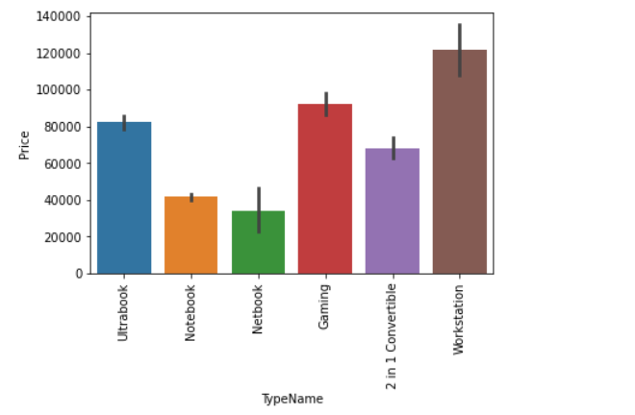
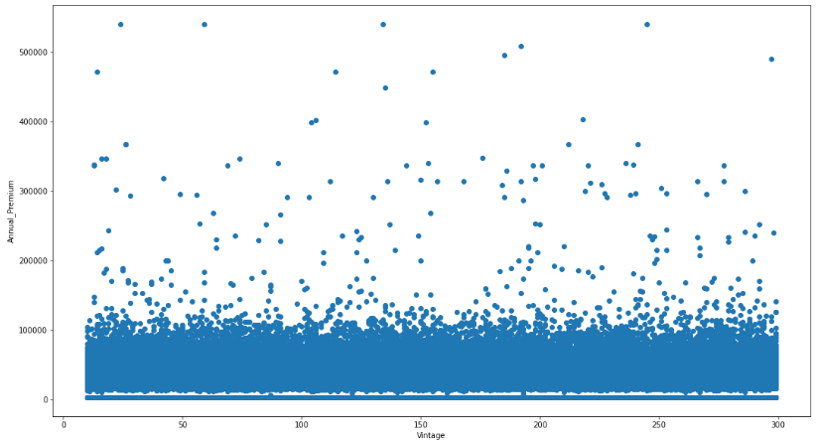
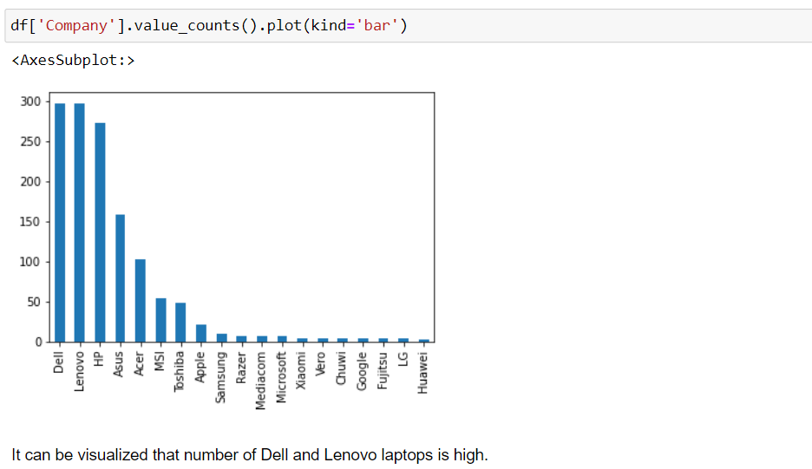
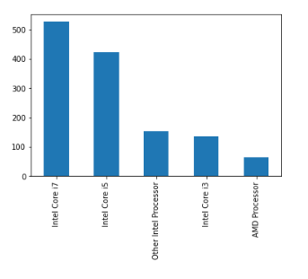
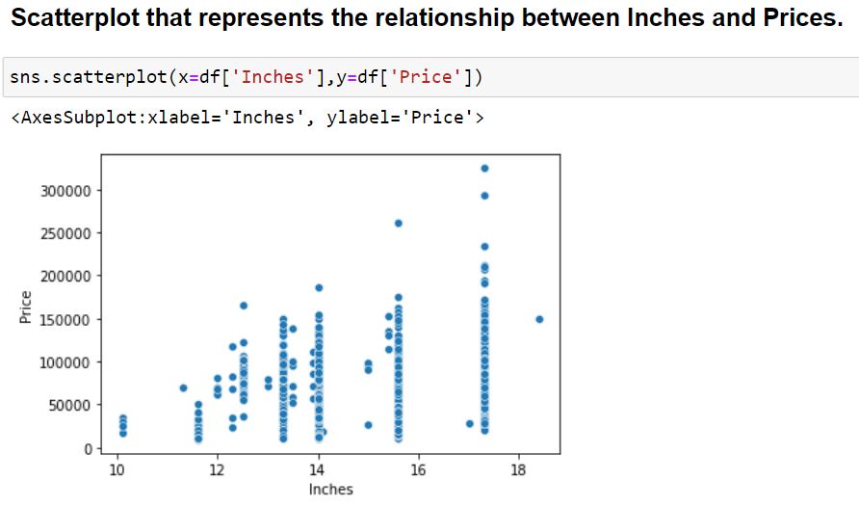
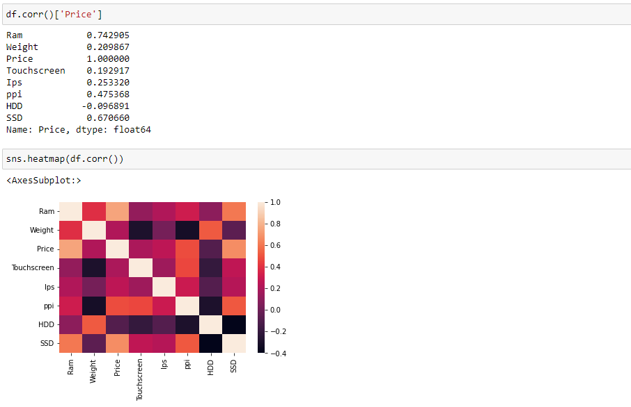
Visualizations

Slide 4
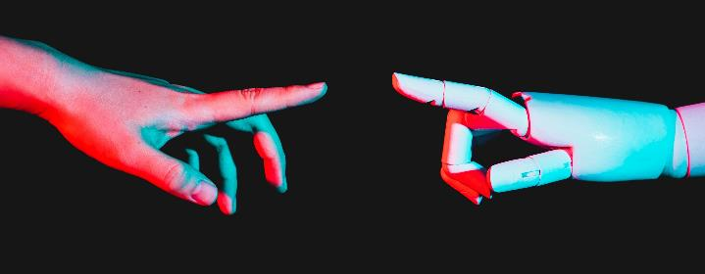
Applied Machine learning models
Linear regression​
Lass0 regression​
Ridge regression​
It assumes a linear relationship between the dependent variable and independent variables
The Lasso regression technique can be used to select the most relevant features from a dataset.
Ridge regression can be useful when dealing with multicollinearity, and when there is a high degree of correlation.

Slide 5
Applied Machine learning models
Decision trees​
Support vector machine
Random forest​
A decision tree is a tree-like model where each node represents a feature or attribute, each branch represents a decision rule, and each leaf node represents a predicted outcome.
SVM is a supervised learning model used for both classification and regression problems. It finds the best possible decision boundary between different classes in the feature space.
It randomly selects a subset of features and data samples to build multiple decision trees, and then averages the output of each tree to make the final prediction. This helps to reduce overfitting and improve the performance of the model.

Slide 6
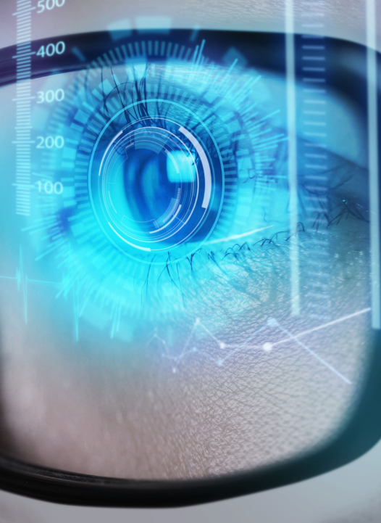
MODEL ACCURACY
MODEL | R-Squared
LINEAR REGRESSION | 0.8073
LASSO REGRESSION | 0.8071
RIDGE REGRESSION | 0.8127
DECISION TREES | 0.8433
SUPPORT VECTOR MACHINE | 0.8083
RANDOM FOREST | 0.8873
MAE
0.21
0.21
0.20​
0.18
0.20
0.15

Slide 7

CONCLUSION
Exploratory Data Analysis (EDA) revealed several insights, such as HP and Dell are the top two brands in terms of the number of laptops sold and the average price of laptops with discrete graphics cards is higher than that of laptops without them.
Machine learning models were built using various algorithms such as linear regression, lasso regression, ridge regression, SVM, decision trees, and random forest to predict laptop prices. Random Forest is the most Accurate ML Model.

Slide 8

THANK YOU

